Slide 1
Fake News

Slide 2
Harvard Referencing
What we will cover:
What referencing is
Why we do it
How we do it
Sources of further information.
This session will show you how to cite and reference in a standard manner using the Harvard system.

Slide 3
What is a reference
A reference is a detailed description of any document from which you have taken information, e.g. A complete book, a chapter within it, journal/magazine article, a website etc.
The Concise Oxford Dictionary (1999, p 301) defines reference as : “the action of referring to a source of information or higher authority “
Notes:
Different system EG MLA APA

Slide 4
Why Reference?
Allow your lecturer to source your research
Help support any arguments you are making.
To demonstrate the breadth of your research.
Required academic practice
Credit the work of others (avoid being accused of Plagiarism)

Slide 5
Plagiarism
The Concise Oxford Dictionary (1999, p263) defines plagiarise as “to take the work or idea of someone else and pass it off as one’s own”
Failure to acknowledge your source of information and pass off someone else’s work as your own could lead to suspicion of plagiarism.
Plagiarism is taken very seriously within the college and it may result in disciplinary action

Slide 6
Cite and Write
Making reference to other work is called citing or “in text” referencing
Full details of the work that are cited are given at the end of your written work in the form of a reference list.
Items that you have used in your background reading, but not cited, may be included under the heading ‘bibliography’, after the reference list.

Slide 7
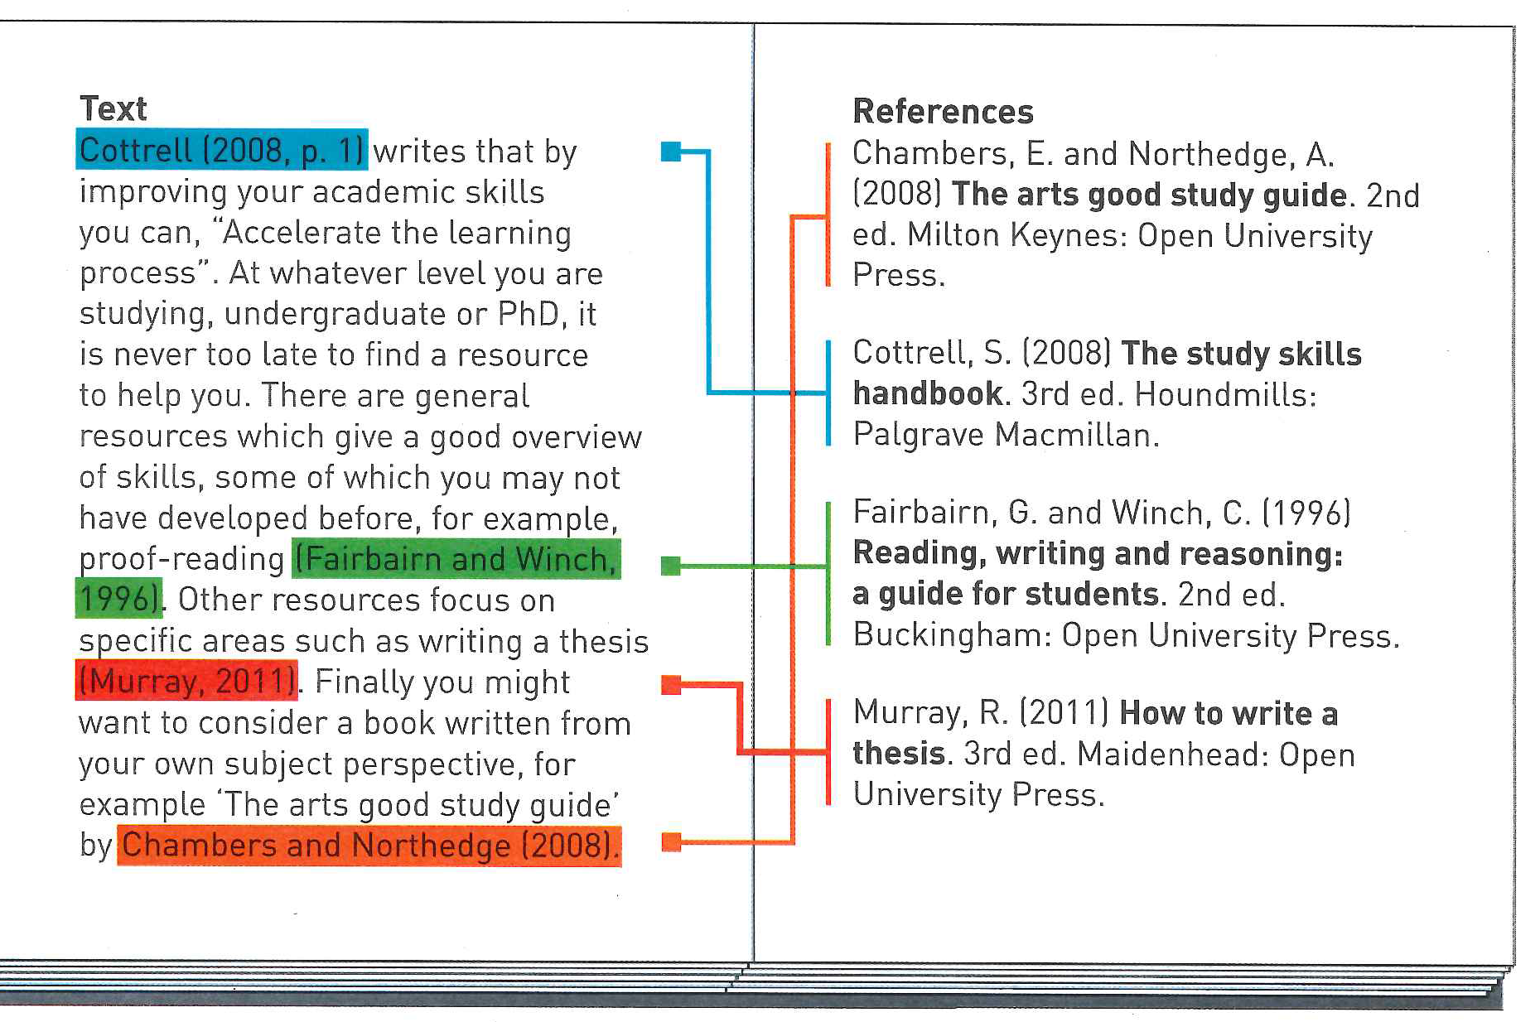
Referencing in context
Citation and Reference.
Notes:
Illustrate with Cottrell study skills plus get the students to source citation and get reference.

Slide 8
What Information Do I Need?
Books
Surname of author(s) , comma, initials(s) full stop.
Year of publication (in brackets)
Title , full stop. (in italics)
Edition
Place of publication (city or town) followed by a colon
Publisher’s name, full stop.
Cottrell, S. (2008) The Study Skills Handbook. 3rd ed. Basingstoke: Palgrave Macmillan.
Tortora, G J.and Derrickson, B. (2007) Introduction to the human body: the essentials of anatomy and physiology. 7th ed. New York: Wiley.
Notes:
Use book, journal and website to illustrate where you are getting the information from – not always straight forward. Got to be in this order and format- part of the standards.

Slide 9
Editors
If the book is edited, use of the editor(s) followed by (ed.) in place of the author.
Example
Haralambos, M (ed) (1996) Sociology: a new approach. 3rd ed. Ormskirk: Causeway Press Ltd.
Corporate Author
When something is published by an organisation or a company there will probably be no individual author that you can identify.
Example
Scottish Social Services Council (2008) Migrant workers research: a report to the Scottish Social Services Council 2008. Dundee: Scottish Social Services Council.

Slide 10
Journals/magazines
Information for journal articles can generally be found on the contents page.
When referencing you need to include:
Surname of the author (s) comma initial (s) full stop.
Year of publication in brackets
Title of the article
Title of the journal (in italics) comma.
Volume number, issue part number (in brackets), comma
First and last pages of the article separated by a hyphen and indicated by the abbreviation “pp” if more than one page.
Examples
Daniels, S (2008) Animal magic, Nursing Standard, 23 (8), p.28
MacBrain, S (2007) Colour me beautiful, Guild News , `April pp 78-86

Slide 11
Electronic Information
Authorship or source of information. If this is not clear use whoever you think is responsible for the item.
The date of “publication” (in brackets) This is the date when the pages were most recently updated. It usually appears at the bottom of the page.
The title (in italics) Use the “home” page title if the specific document title is unclear.
The type of resource in square brackets eg [online]
The URL (uniform resource locator – for a web address)
The date the source was accessed [in square brackets]
Examples:
U.S. National Library of Medicine (2008) Health topics: Stress [Online] MedlinePlus Available at:
http://www.nlm.nih.gov/medlineplus/stress.html [assessed 4th Dec 2008]
Web address (URLs) may change or disappear completely this is why it’s essential that the date you actually accessed the information is recorded. Get into good habits, cut and paste the web address to any document you are working on. It is easier to delete information you no longer require than trying to back track trying to relocate your source.

Slide 12
Quotations
If you make a direct quote from another source of information you must use quotation marks to indicate this. The author(s) and date must be stated and if possible the page number from which the quote was taken.
Example
Webb (1999) said that “prejudice is commonly based on , or justified by, a stereotype.” (Webb 1999, p16)
Try not to use quotations too often and vary the way you introduce them into your text. The full reference to your source of the quotes should be listed with your other references

Slide 13
Listing your references at the end of your work
Only make reference to documents or sources of information you have referred to within the text of your work. The list must be in alphabetical order of the author’s surname.
Example
[anon]
Haralambos, M
Tortora, G. J.
Webb
Where there is no obvious author use [anon]
If you cannot find a date of publication, make this clear eg [no date] or [undated]

Slide 14
Think About it………
Who
When
What
Where
How
Notes:
Logically - you are just trying to help someone else retrace your research path. Use book again to illustrate the who what when etc. So far only shown book but logic follows no matter the format of item.

Slide 15
Good habits
Take the full details of each source of information as you use it as it may not be available later. Cut and paste the address of any electronic sources as you use them. If your unsure of how to do any of this, ask for assistance. Library and lecturing staff are always available to help.
Notes:
Template sheet, example sheet plus the links to some of the tools get into the habit of using.

Slide 16
Where Do I Find the Reference details?
This, obviously, varies depending on the type of source you are citing.
Books - check the title page and the back of title page.
Journals – check the front cover, spine or first page. Specific article details can be found on the content page or the beginning or end of the article itself.
Websites – First page of the website, Url at the top address bar. Plus. If printing , the url will be at the bottom of the page Dates Etc are usually at the bottom of the page. http://www.bbc.co.uk/science/0/21685448

Slide 17
Practice with notes
Importance of good practice at this stage in your academic career.
Refer back to notes and other Online resources which cover all situations:
Anglia Uni. used for checking problems. http://libweb.anglia.ac.uk/referencing/harvard.htm
REF ME App.
Neil’s Toolbox http://www.neilstoolbox.com/bibliography-creator/
Microsoft reference Tool - Short video from Anglia Rusking Uni. on how to use it.
Notes:
Also see other VLE links on separate page.

Slide 18
Using Microsoft word
Mary has a little lamp it’s face as white as snow and everywhere that Mary went the lamp was sure to go.
(please note, while the basics are there, the reference does not conform with the college harvard system)
Mary had a little lamb (Brown, 2016) it’s face as white as snow (BBC, 2016) and everywhere that Mary went the lamb was sure to go (Brown, 2016)
BBC, 2016. Nursery Rhymes. [Online]
Available at: www.bbc.co.uk
[Accessed 16 aug 2017].
Brown, J., 2016. How to look after lambs. Edinburgh: Phaidon.
Brown, J., 2016. Lost sheep. 2nd ed. London: Penguin.

Slide 19
Short Quiz
A bit of fun you may like to try for yourself to test your knowledge!
Harvey the Referencing Cat….
http://library.northampton.ac.uk/liberation/ref/cat.php

